Slide 1

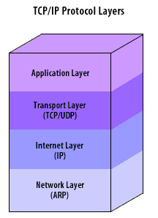
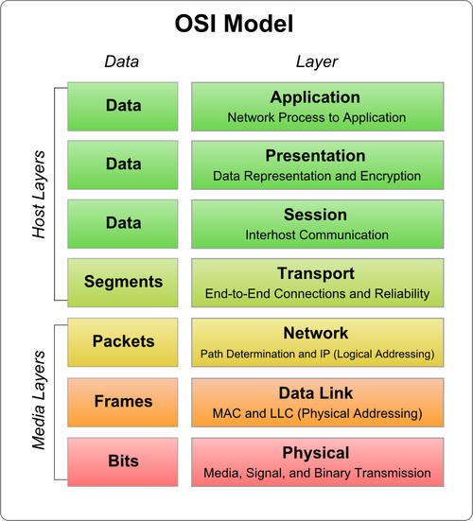
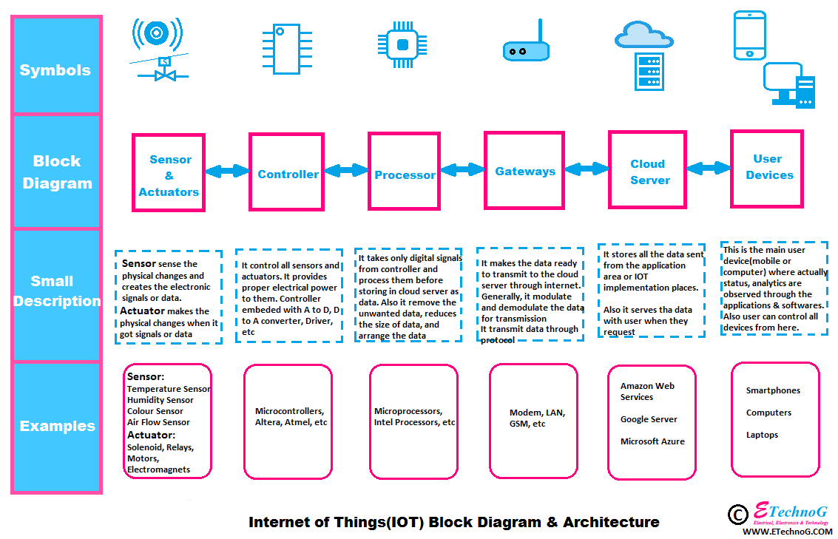
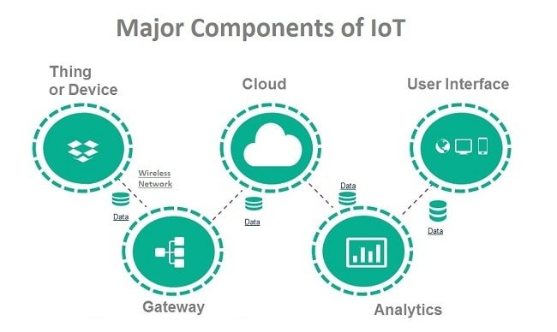
Internet Application
By: Lehela Campbell
Dr. Marcella Wilson
Computer Technology Department – Bowie State University
CONCLUSION
In conclusion, throughout the course I learned about the layers of the TCP/IP layer, and the layers within the OSI model. In addition, I learned about the IOT network. The IOT is a group of interconnected devices that are all connected to the internet in a way that makes information easily accessible and shareable. The problem with the IOT is that the high volume of users makes it more susceptible to cyber attacks. Although the IOT is convenient there are many risk associated with it and it is important to be well informed about how to secure and protect data and the networks that data is being stored and shared on.
References
Garcia, N., Alcaniz, T., González-Vidal, A., Bernabe, J. B., Rivera, D., & Skarmeta, A. (2020, October 31). Distributed real-time SlowDoS attacks detection over encrypted traffic using Artificial Intelligence. Retrieved from https://www.sciencedirect.com/science/article/pii/S1084804520303362
Security Analysis of Network Anomalies Mitigation Schemes in IoT Networks. (n.d.). Retrieved from https://ieeexplore.ieee.org/abstract/document/9016241
Ullah, I., & Mahmoud, Q. H. (2020, March 23). A Two-Level Flow-Based Anomalous Activity Detection System for IoT Networks. Retrieved from https://www.mdpi.com/2079-9292/9/3/530/htm#sec4-electronics-09-00530
Rohde & Schwarz GmbH & Co KG. “Machine Learning: Time Based Anomaly Detection.” Machine Learning: Time Based Anomaly Detection | Rohde & Schwarz, www.rohde-schwarz.com/us/solutions/test-and-measu110.htm.
Ahmed, Mohiuddin, et al. “A Survey of Network Anomaly Detection Techniques.” Journal of Network and Computer Applications, Academic Press, 11 Dec. 2015,
Background
The reliance on computers and other devices connected to the IOT network have grown tremendously since the start of the COVID-19 Pandemic in 2020. As a result, there is a greater need to secure devices connected to the IOT network. The best way to protect your private information protecting your investment is by investing in proper, preventative and proactive software. The basics are making sure to have an antivirus software installed on all capable devices. And finally, protect your private data while using the IOT network by using an IDS, or IPS.
Questions
What are the layers of the TCP/IP layers?
What are the layers of the OSI model?
What is the IOT?
What methods or tools can be used to mitigate network attacks?
What are some of the downfalls of the IOT network?
The presentation shows demonstrations of the topics discussed in the network and IOT modules and how they work.
METHODS & RESULTS

